Slide 1

MARKET BASKET ANALYSIS
By Girish Prakash Jamnale

Slide 2
INDEX
PROBLEM STATEMENT
DATASETS
EDA & VISUALIZATION
WHAT IS MARKET BASKET ANALYSIS
ASSOCIATION RULES MINING
APRIORI ALGORITHM

Slide 3
PROBLEM & DATASET Olist, a leading Ecommerce company has been facing losses due to obsolete inventory, as unsold inventory inventory add to storage and warehouse costs. The objective of the project is to manage inventory cost by identifying top products that contribute to revenue using market basket analysis to analyze the purchase behavior of individual customers to estimate with relative certainty, what items are more likely to be purchased individually or in combination with some other products.

Slide 4
DATASETS
Orders.csv: Contains particulars about the order placed.
Orders_items.csv: Contains data about the items bought
Customers.csv: Contains information about customers who placed orders.
Products.csv: Contains particulars about product as dimensions and category of product.
Payments.csv: Contains details such as mode of payment.
Data Dictionary: Explains all the attributes present in all the various tables.

Slide 5
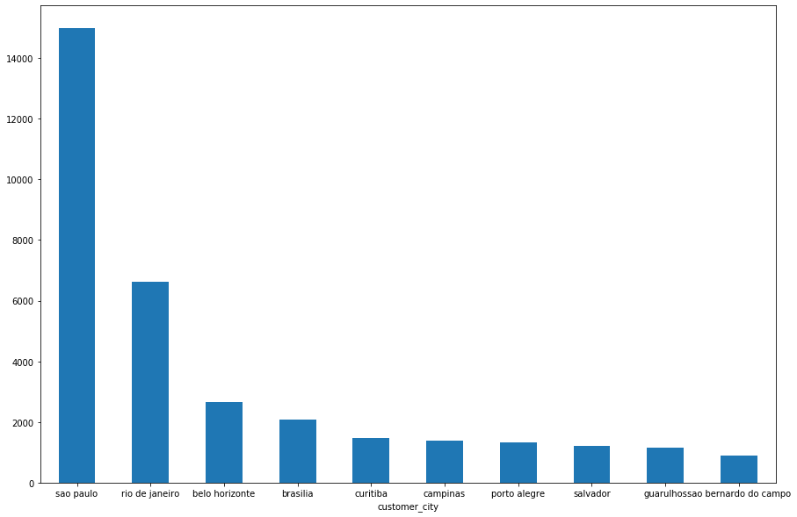
CUSTOMERS BY CITY
Sao Paulo & Rio De Janeiro has the most number of customers.

Slide 6
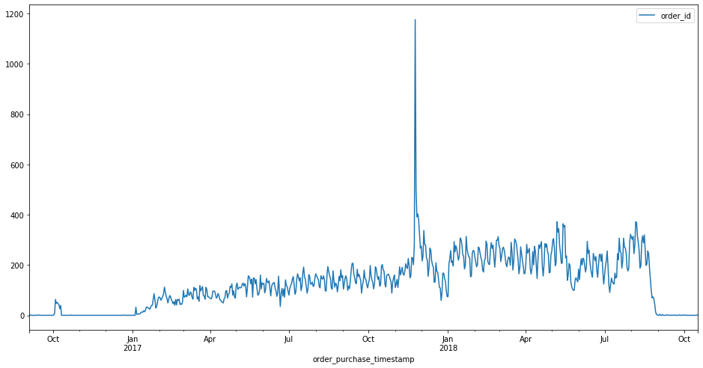
From the graph above, we can see that there is a peak in the region of Christmas.

Slide 7
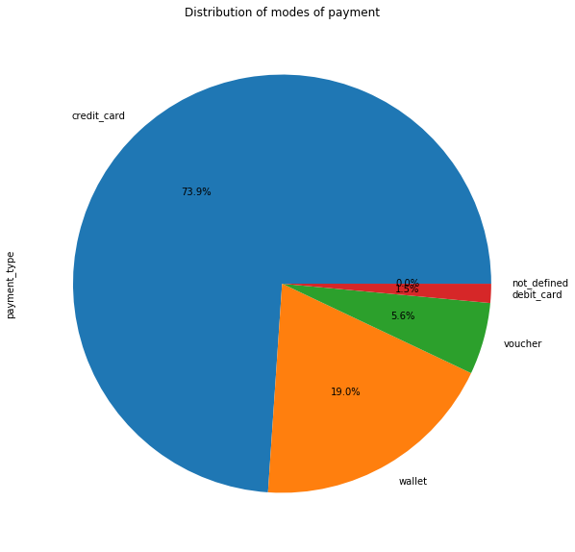
DISTRIBUTION OF PAYMENT MODE
74% of payment is through credit card and 19% is through Wallets

Slide 8
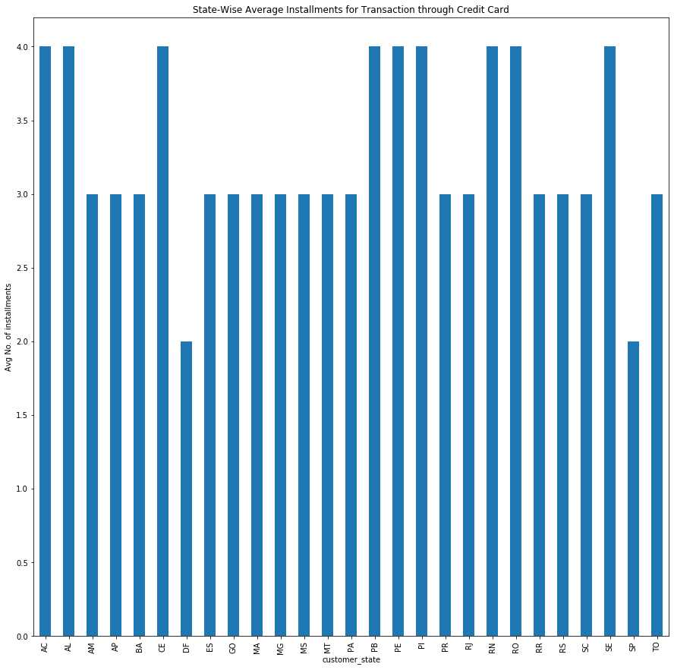
STATEWISE AVERAGE NUMBER OF INSTALLMENT
Customers from most of the states usually pay in 3 - 4 installments whereas there are only two states where avg no. of installments are 2

Slide 9
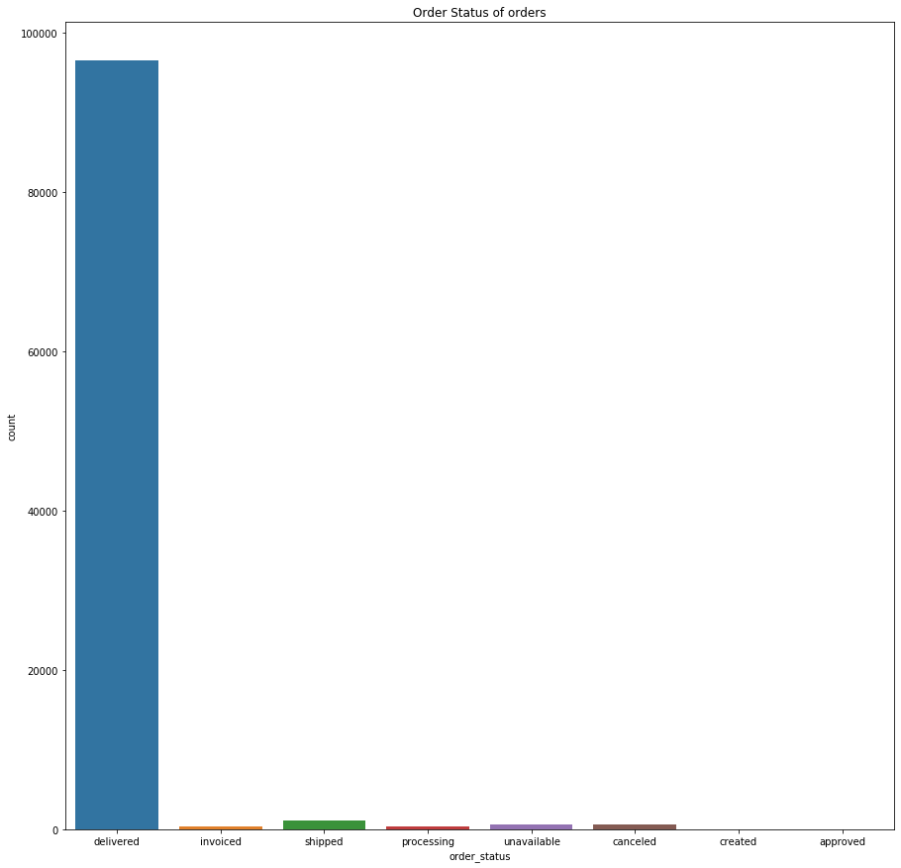
ORDER STATUS
Here most of the orders are delivered, however there are very few orders which are unavailable/shipped/cancelled etc.

Slide 10
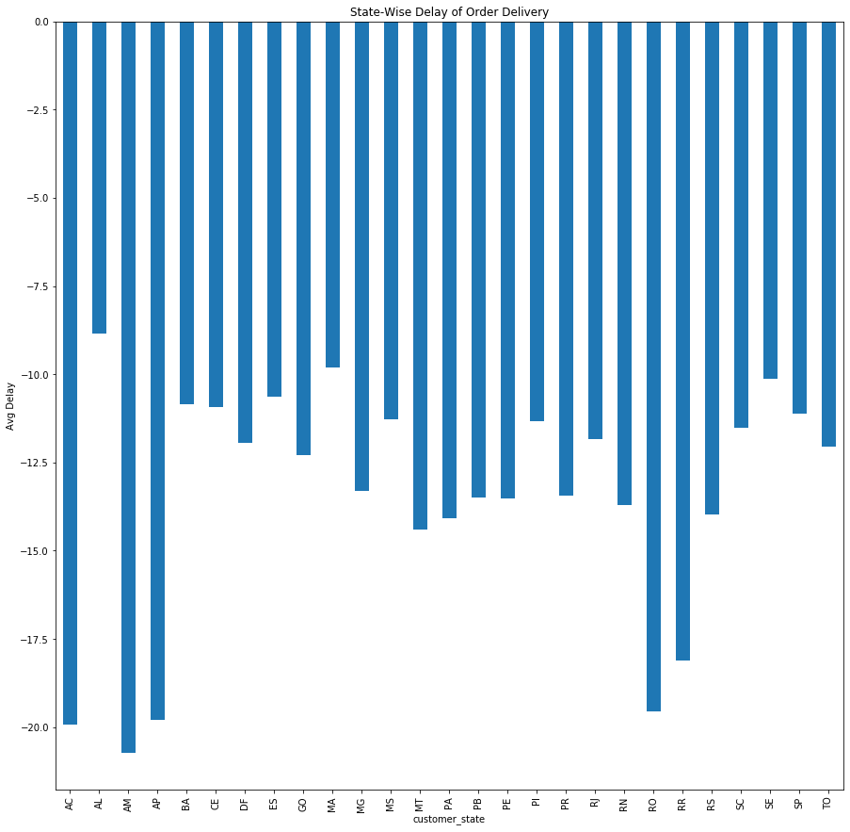
STATEWISE ORDER DELAY
On an average, delivery of product is early than the estimated

Slide 11
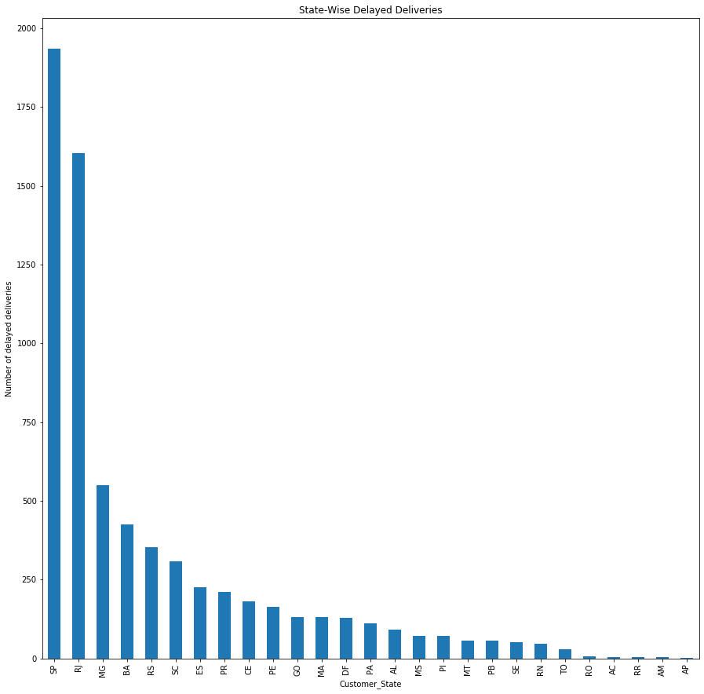
STATEWISE DELAYED DELIVERIES
Most of the delays are from Sao Paulo and Rio De Jenerio

Slide 12
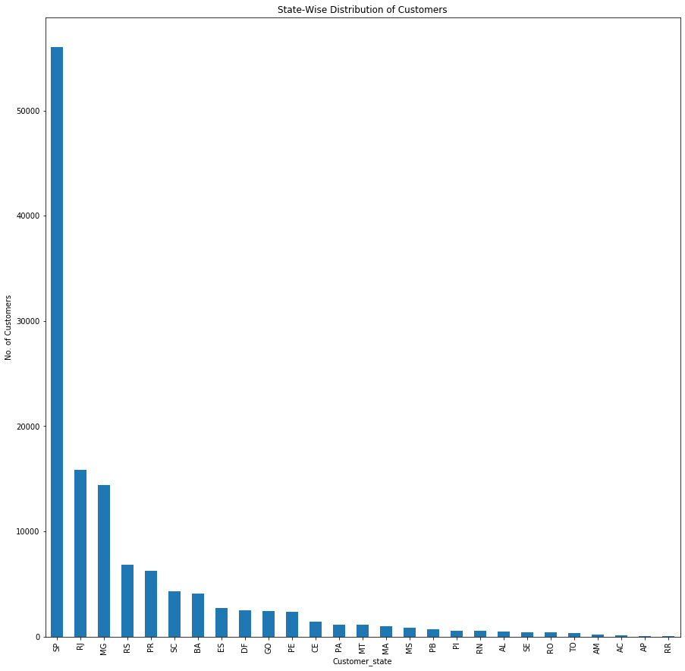
STATEWISE CUSTOMER DISTRIBUTION
Most of the customers are from Sao Paulo. As a result of this, there is more sales in Sao Paulo

Slide 13
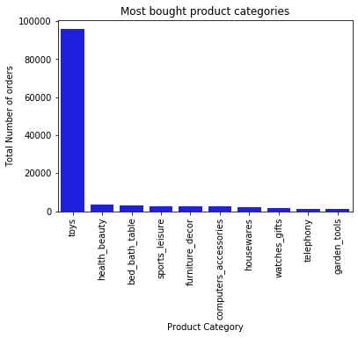
Toys is the most bought product category.

Slide 14
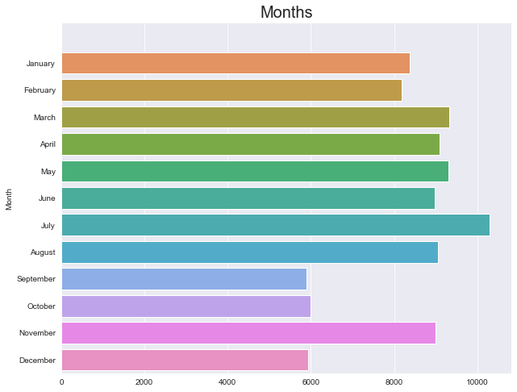
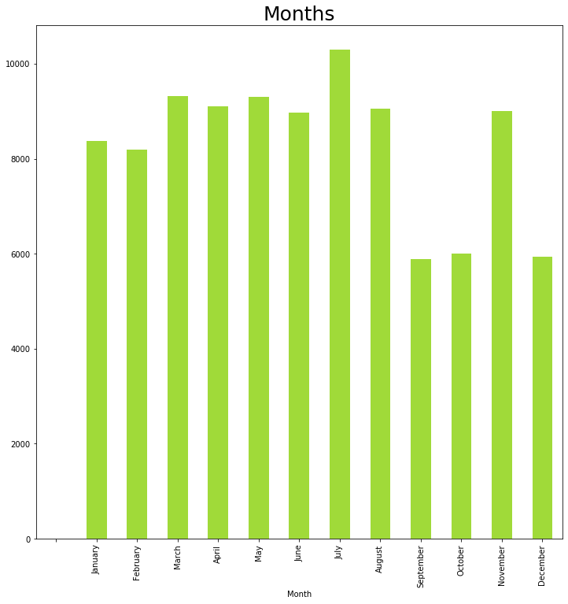
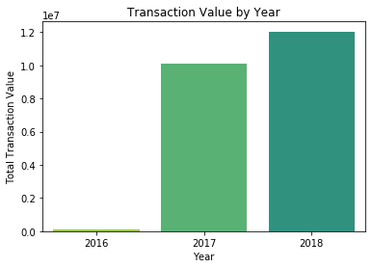
TRANSACTION TRENDS

Slide 15
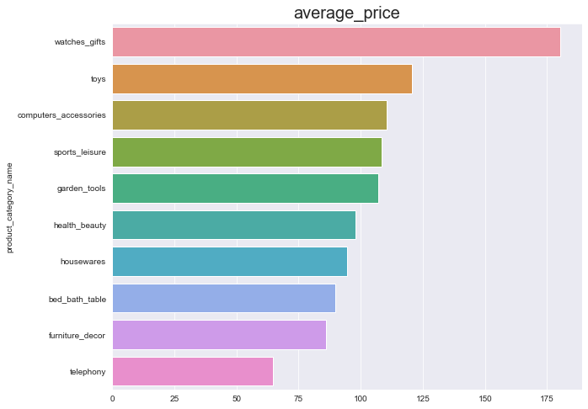
AVERAGE BUY PRICE OF PRODUCT CATEGORY

Slide 16
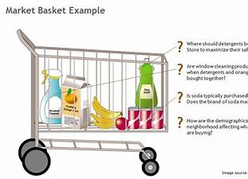
WHAT IS MARKET BASKET ANALYSIS
Market basket analysis (MBA) is an example of an analytics technique employed by retailers to understand customer purchase behaviors. It is used to determine what items are frequently bought together or placed in the same basket by customers. It uses this purchase information to leverage effectiveness of sales and marketing.
Reference: Technopedia

Slide 17
Association Rule Mining
Association Rule Mining is used when you want to find an association between different objects in a set, find frequent patterns in a transaction database, relational databases or any other information repository. The applications of Association Rule Mining are found in Marketing, Basket Data Analysis (or Market Basket Analysis) in retailing, clustering and classification.
The most common approach to find these patterns is Market Basket Analysis, which is a key technique used by large retailers like Amazon, Flipkart, etc to analyze customer buying habits by finding associations between the different items that customers place in their “shopping baskets”. The discovery of these associations can help retailers develop marketing strategies by gaining insight into which items are frequently purchased together by customers. The strategies may include:
Changing the store layout according to trends
Customer behavior analysis
Catalog design
Cross marketing on online stores
What are the trending items customers buy
Customized emails with add-on sales etc..
Online retailers and publishers can use this type of analysis to:
Inform the placement of content items on their media sites, or products in their catalog
Deliver targeted marketing (e.g. emailing customers who bought products specific products with other products and offers on those products that are likely to be interesting to them.)
Reference: KdNuggets

Slide 18
APRIORI ALGORITHM
Apriori algorithm assumes that any subset of a frequent itemset must be frequent. Its the algorithm behind Market Basket Analysis.
Measure 1: Support.
This says how popular an itemset is, as measured by the proportion of transactions in which an itemset appears
Measure 2: Confidence.
This says how likely item Y is purchased when item X is purchased, expressed as {X -> Y}. This is measured by the proportion of transactions with item X, in which item Y also appears.
Measure 3: Lift
This says how likely item Y is purchased when item X is purchased, while controlling for how popular item Y is.

